Slide 1
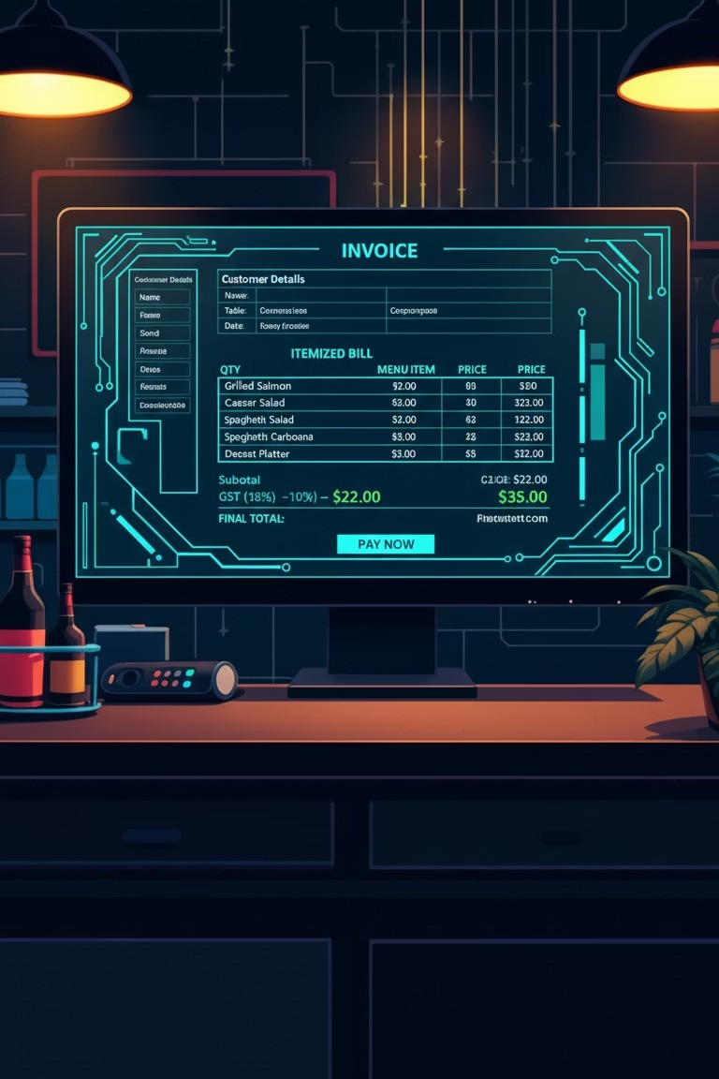
Project Number: 13 Restaurant Billing System
Presented by: Ankit Kumar
ERP-ID: 10211
Guided by: Naina Devi

Slide 2




Presentation Roadmap
This presentation will walk you through how I have made C-based Restaurant Billing System .
Introduction to the Project
Tools & Technology used
Code & working of project.
04
Key Advantages & Benefits
Real-World Applications
Features & Future Scope

Slide 3

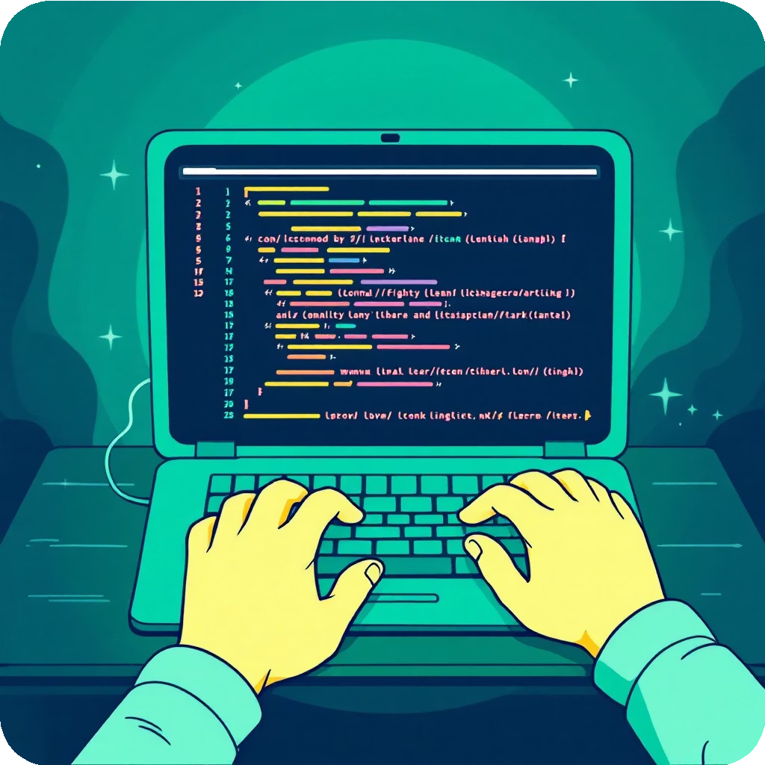

Introduction to the System
Our Restaurant Billing System is a Command Line Interface (CLI) application designed to streamline and automate the core processes of a food service establishment.
Automated Order & Billing
Designed to simplify the ordering and payment workflow, reducing manual effort and potential errors.
Core Functionalities
Interactive Menu Display Efficient Order Processing Automated Bill Generation
This system aims to improve operational efficiency and customer satisfaction through a seamless transactional experience.

Slide 4



Tools &Technology Stack
The system is built using foundational programming concepts and accessible development tools, making it robust and easy to understand.
C Language
The entire application is developed in C, leveraging standard libraries like <stdio.h> for input/output operations, demonstrating strong procedural programming principles.
Visual Studio Code
VS Code served as the primary Integrated Development Environment (IDE), offering a lightweight yet powerful platform for coding and debugging.
GCC Compiler (MinGW)
MinGW's GCC compiler was used to compile the C source code, ensuring compatibility and efficient execution on Windows environments.
The implementation relies on fundamental C programming structures such as loops, conditional statements, and variables for logical flow and data handling.

Slide 5
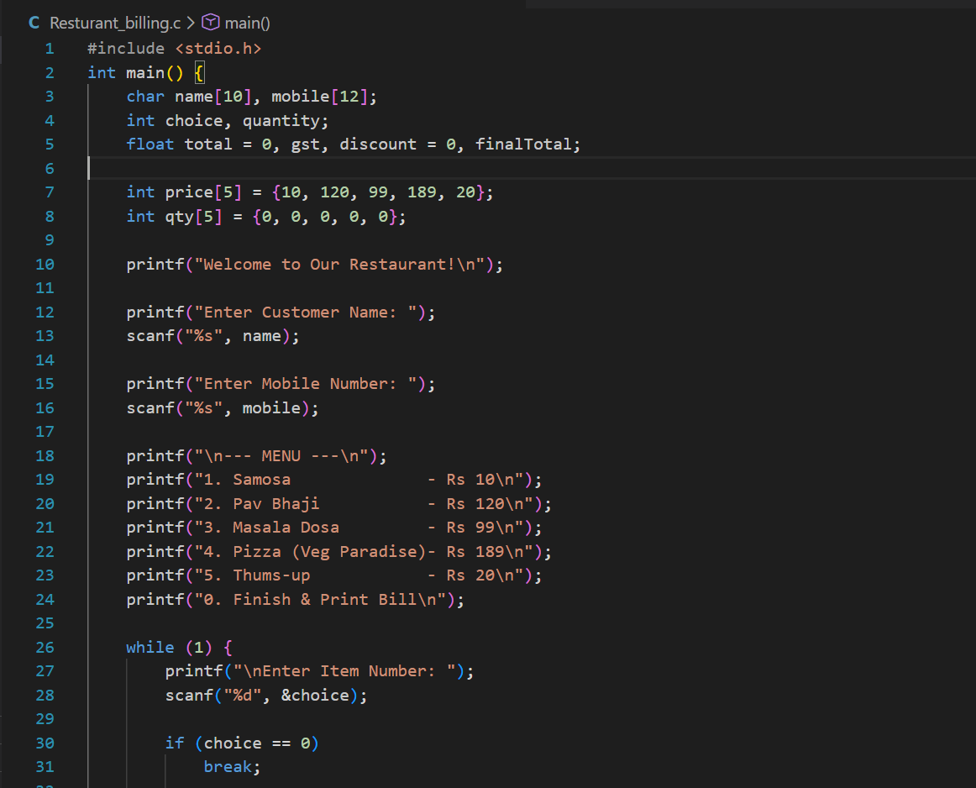
Source code (VS code)

Slide 6
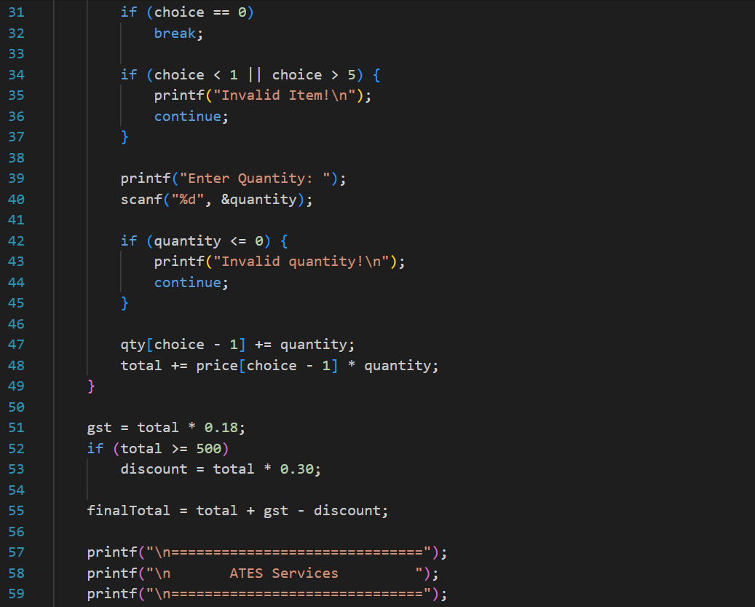
Source code (VS code)

Slide 7
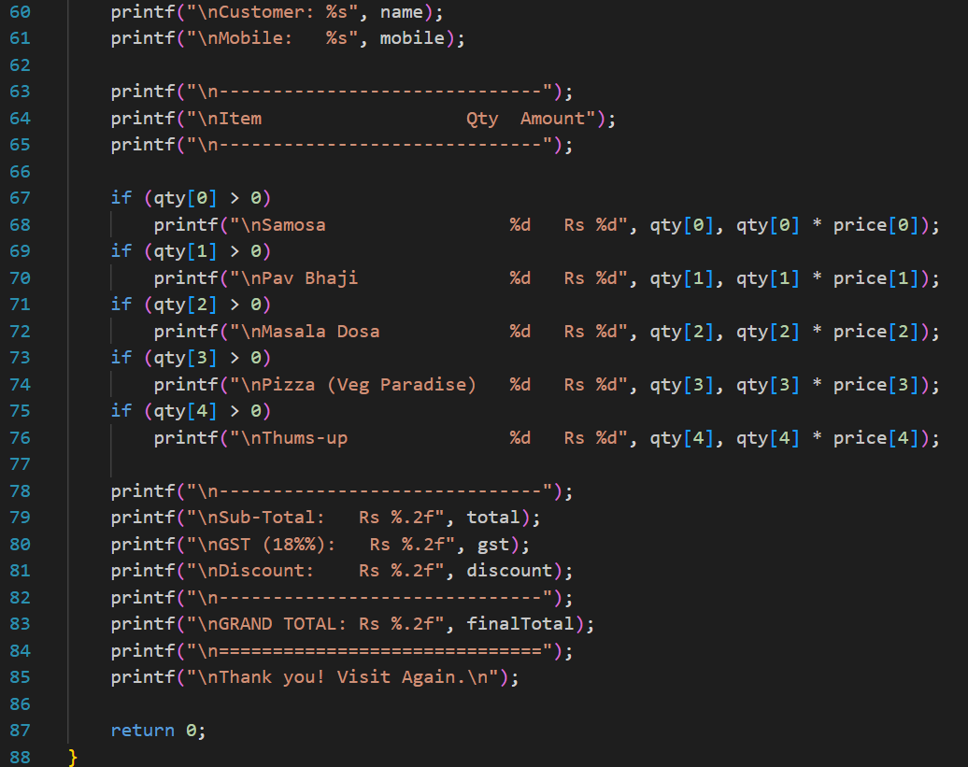
Source code (VS code)

Slide 8
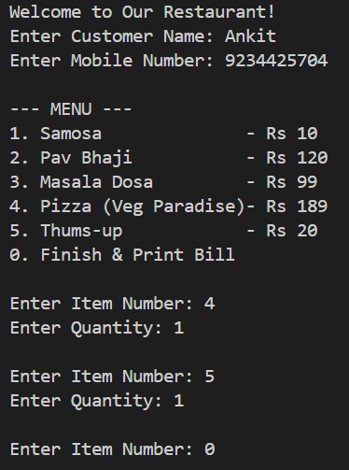
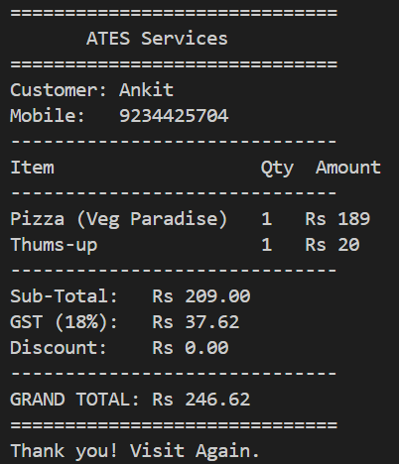
Order & Bill

Slide 9

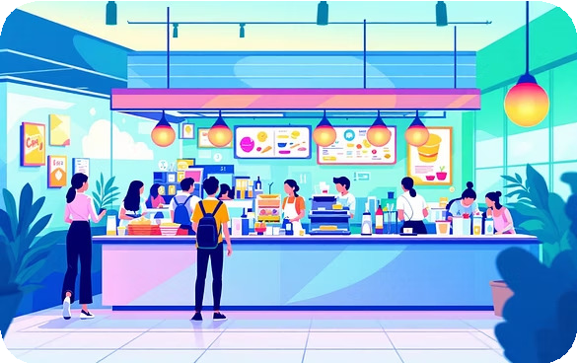

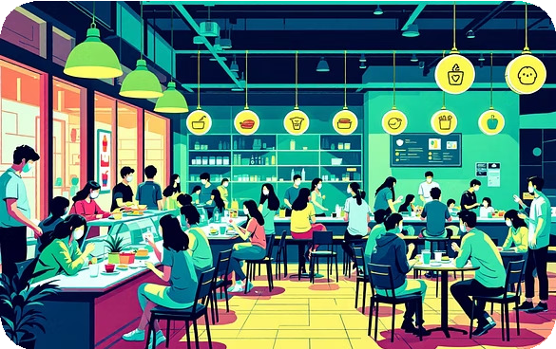
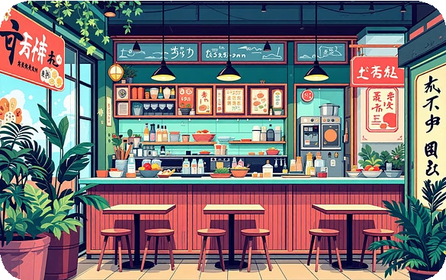
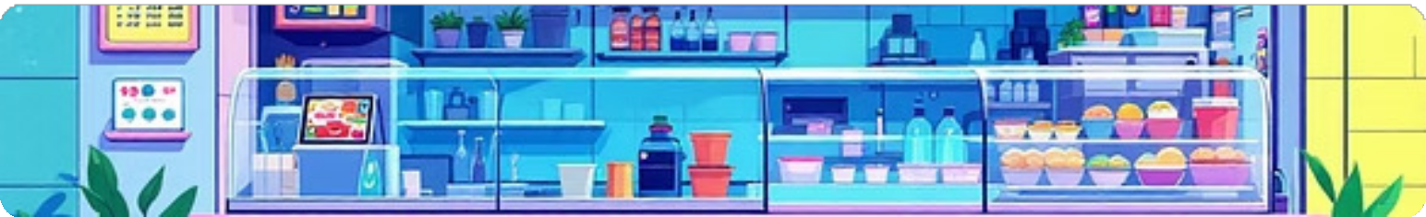
Real-World Applications
The flexibility and efficiency of this system make it ideal for a variety of food service environments seeking to modernize their operations.
Fast Food Chains: Rapid order processing for high-volume transactions.
Cafes: Seamless billing for quick service and diverse menu items. Canteens: Efficient management of daily meals for large populations. Small Restaurants: Cost-effective solution for independent eateries.
Takeaway Counters: Streamlined billing for off-premise consumption.

Slide 10


Features & Future Scope
While currently functional, our system has a clear roadmap for expansion, incorporating advanced features for enhanced utility and integration.
Current Features Future Enhancements
File Handling for Sales Records
Implement persistent storage to save daily sales data, enabling reporting and historical analysis.
Formatted Bill Generation
The system generates a clear, formatted bill including all ordered items, prices, taxes, and applied discounts.
Database Integration (SQL)
Integrate with a relational database for robust inventory management, real- time menu updates, and advanced analytics.
Customer Details Capture
Graphical User Interface (GUI)
Records essential customer information such as name and mobile number for personalized service or loyalty programs.
Develop a modern GUI to enhance user interaction, making the system more intuitive and visually appealing for diverse users.

Slide 11

Thank You!
I hope to get good Marks.
Feel free to ask any questions. Contact: ankit.kumar1@rungta.org

